Slide 1
Integrating Power BI
with Azure Synapse Analytics

Slide 2

Agenda
In this session we’ll start with how Power BI connects to Synapse Analytics
We’ll then look at useful features in both Power BI and Synapse Analytics that can enhance workloads
We’ll take a quick look at Dedicated SQL Pools and Serverless SQL Pools
Then it’s…Demo time!

Slide 3
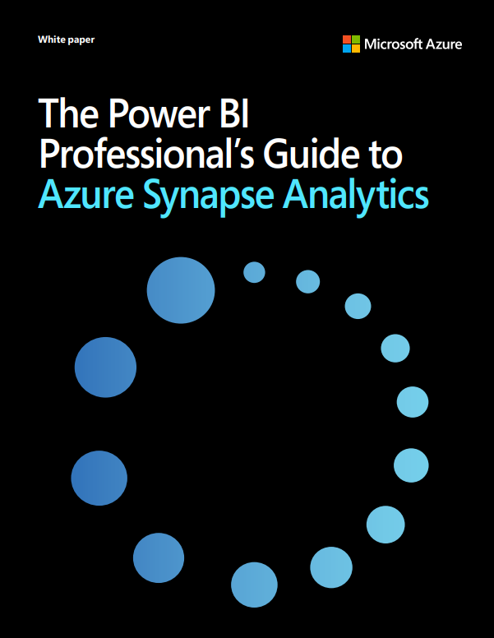
Microsoft Whitepaper
Microsoft have produced a whitepaper (35 pages)
Contains an overview of Azure Synapse Analytics and the relevant services to Power BI
Instructions of how to build Power BI Datasets & Reports from Synapse Studio
https://azure.microsoft.com/en-us/resources/power-bi-professionals-guide-to-azure-synapse-analytics/

Slide 4
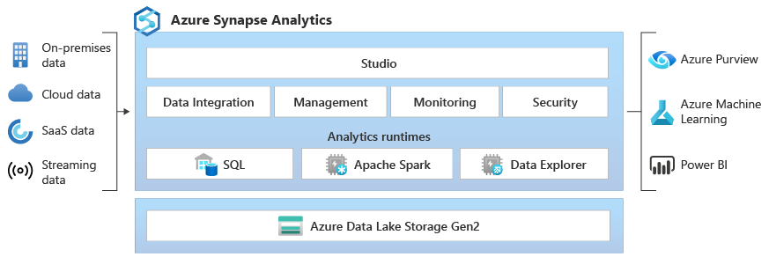
Azure Synapse Analytics
Dedicated SQL Pools to run SQL data warehousing workloads in a Massively Parallel Processing (MPP) system
Import Data into Dedicated SQL Pools Tables with appropriate indexing (ColumnStore, Clustered) and data distribution
Serverless SQL Pools to run SQL workloads over data in Azure Storage, Data Lake, CosmosDB, Dataverse
Use T-SQL to run SELECT commands over data stored externally, without moving data

Slide 5
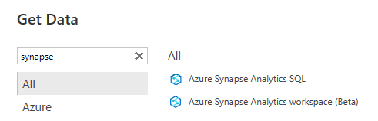
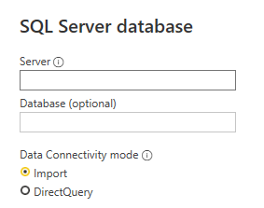
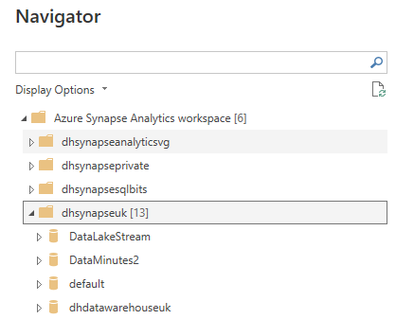
Connecting to Synapse Analytics
There are 2 connectors in Power BI Desktop
Azure Synapse Analytics SQL
Azure Synapse Analytics workspace (Beta)
DirectQuery & Import
Import only

Slide 6


Features
Synapse Analytics
Power BI
Materialized Views
Aggregations (Manual & Automatic)
Result-Set Caching
Incremental Refresh
Workload Classification
Hybrid Tables (Import & DirectQuery)

Slide 7
Dedicated SQL Pools
Query concurrency depends on:
g
The DWU tier the pool is currently set to
The Resource Class a user is assigned to when running a query
Maximum Number of Queries per DWU tier:
DWU100c
DWU200c
DWU500c
DWU1000c
DWU30000c
4
8
20
32
128
RAM (GB)
60
120
600
1,200
18,000

Slide 8
Serverless SQL Pools
Serverless SQL Pools are always on, no need to resume/pause/stop
Resources are allocated automatically, there are no scaling options (no DWU concept)
Best Practices
Try and ensure Power BI, Synapse Analytics, and Azure Storage are in the same region
Use Parquet file format where possible
Assign the smallest data types possible
File sizes evenly ranged from 100MB to 10GB each

Slide 9

Serverless SQL Pools
We can use a SQL metadata function filepath() to “partition prune” when querying data in Azure Storage
Data Lake
Serverless SQL Pools View
Power BI Query
\EventYear=2022\
\EventMonth=03\
\EventDate=2022-03-01
\EventDate=2022-03-02
\EventDate=2022-03-03
CREATE VIEW…
AS
SELECT filepath(1) AS EventYear,
filepath(2) AS EventMonth,
filepath(3) AS EventDate,
…
SELECT…
…WHERE EventDate = ‘2022-03-02’
EventDate is the 3rd level in the folder hierarchy

Slide 10
Demo
Dedicated SQL Pools – Materialized Views
Serverless SQL Pools – Partition Filtering

Slide 11
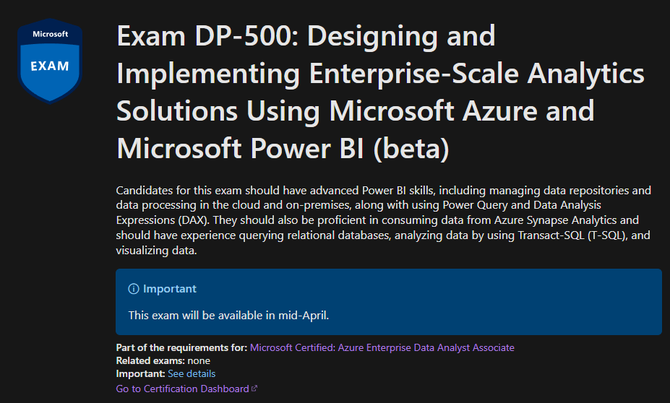
New Certification
Available ~mid-April
Covers:
Power BI
Azure Purview
Azure Synapse Analytics
Azure Data Lake Gen2
DP-500: Designing and Implementing Enterprise-Scale Analytics Solutions Using Microsoft Azure and Microsoft Power BI (beta) - Learn | Microsoft Docs

Slide 12
References
Memory and concurrency limits - Azure Synapse Analytics | Microsoft Docs
Quickstart: Linking a Power BI workspace to a Synapse workspace - Azure Synapse Analytics | Microsoft Docs
Performance tuning with materialized views - Azure Synapse Analytics | Microsoft Docs
Performance tuning with result set caching - Azure Synapse Analytics | Microsoft Docs
Quickstart: Create a workload classifier - T-SQL - Azure Synapse Analytics | Microsoft Docs
Azure SQL DW Materialized Views (part 1) – Niko Neugebauer (nikoport.com)
Quickstart: Create a workload classifier - Portal - Azure Synapse Analytics | Microsoft Docs
COPY INTO (Transact-SQL) - (Azure Synapse Analytics) - SQL Server | Microsoft Docs
https://docs.microsoft.com/en-us/power-bi/enterprise/aggregations-auto
https://powerbi.microsoft.com/en-us/blog/announcing-public-preview-of-hybrid-tables-in-power-bi-premium/
Monitor your dedicated SQL pool workload using DMVs - Azure Synapse Analytics | Microsoft Docs
Copy and transform data in Azure Synapse Analytics - Azure Data Factory & Azure Synapse | Microsoft Docs
Capacity limits for dedicated SQL pool - Azure Synapse Analytics | Microsoft Docs
DBCC PDW_SHOWMATERIALIZEDVIEWOVERHEAD (Transact-SQL) - SQL Server | Microsoft Docs
Monitor your dedicated SQL pool workload using DMVs - Azure Synapse Analytics | Microsoft Docs
GitHub - JocaPC/qpi: Query Performance Insight - analyze performance of your SQL Server Database Engine

